Slide 1
Application For: A Conditional Use for Grassy Key Resort Group, LLC
City of Marathon City Council May 14, 2019
Notes:
Good evening.
This is an application for a conditional use for applicant Grassy Key Resort Group, LLC, agent is Lesley Rhyne

Slide 2
Applicant/Owner: Grassy Key Resort Group, LLC Agent: Lesley Rhyne
The project site is located at 58182 Overseas Highway nearest mile marker 58.
Requesting a Conditional Use Permit and Development Agreement for development of Mixed Use zone property having the real estate numbers 00370940-000000.
Total acreage: Approx. 2.24 acres
Total square feet: 97,601 square feet.
Notes:
The project is the formerly the location of Casa Del Sol Resort and Yellowtail Inn. The nearest MM is 58.
The applicant is requesting a CU for and DA for Hotel/Motel/Resort.
The total area is approximately 2 and a quarter acres.

Slide 3
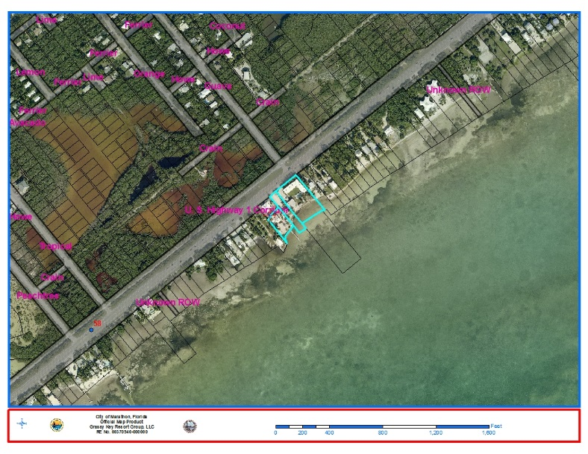
Location Map
Notes:
Here is the location of the three contiguous parcels
To the North – Conservation Native areas and Conservation Residential -- Crains Subdivision
South – Oceanside
East and West – Mixed uses and Residential Medium zones –
east - Residential homes and vacant lots
west - Hideaway Café, White Sands Inn, and Rainbow Bend

Slide 4
Surrounding Zoning and Uses
FLUM Designation: Mixed Use Commercial (MU-C)
Current Zoning: Mixed Use (MU)
 | Zoning | Use
North | Conservation-Native Area and Residential Conservation | Crain Subdivision, Grassy Key
East | Mixed Use and Residential Medium | Residential Homes and Vacant Lots
South | Atlantic Ocean | N/A
West | Mixed Use and Residential Medium | Crain Subdivision, Hideaway Café, White Sands Inn, and Rainbow Bend
Notes:
The future land use designation is Mixed Use-Commercial
The current zone designation is Mixed Use
The project is compatible with surrounding uses

Slide 5
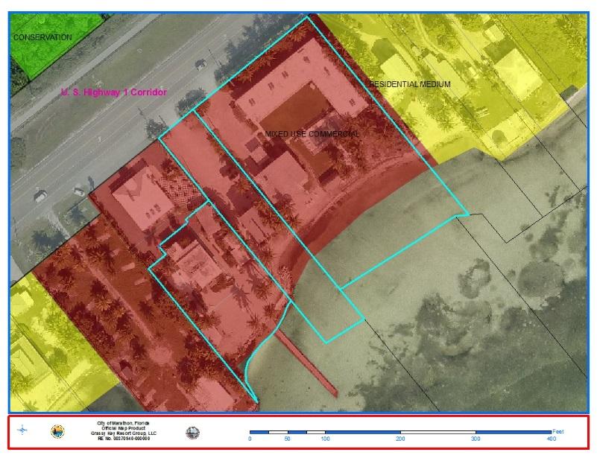
Future Land Use Map Designation
Notes:
Here is the map showing the FLUM

Slide 6
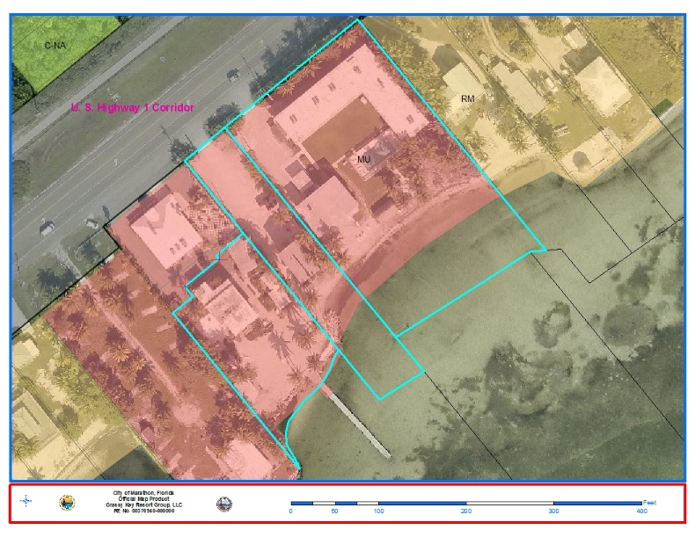
Current Zoning
Notes:
Here is the map showing the current zone, MU

Slide 7
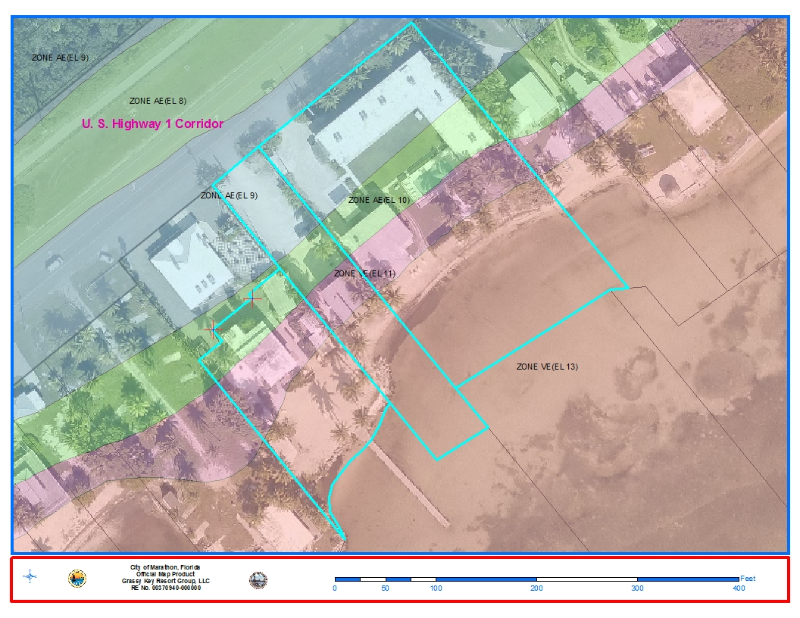
FEMA Flood Zones
Notes:
This map shows that the most of the project will fall under the AE 10 and VE 11 FEMA zones. The VE 15 zone is the location of the existing footprint of the previous dock.

Slide 8
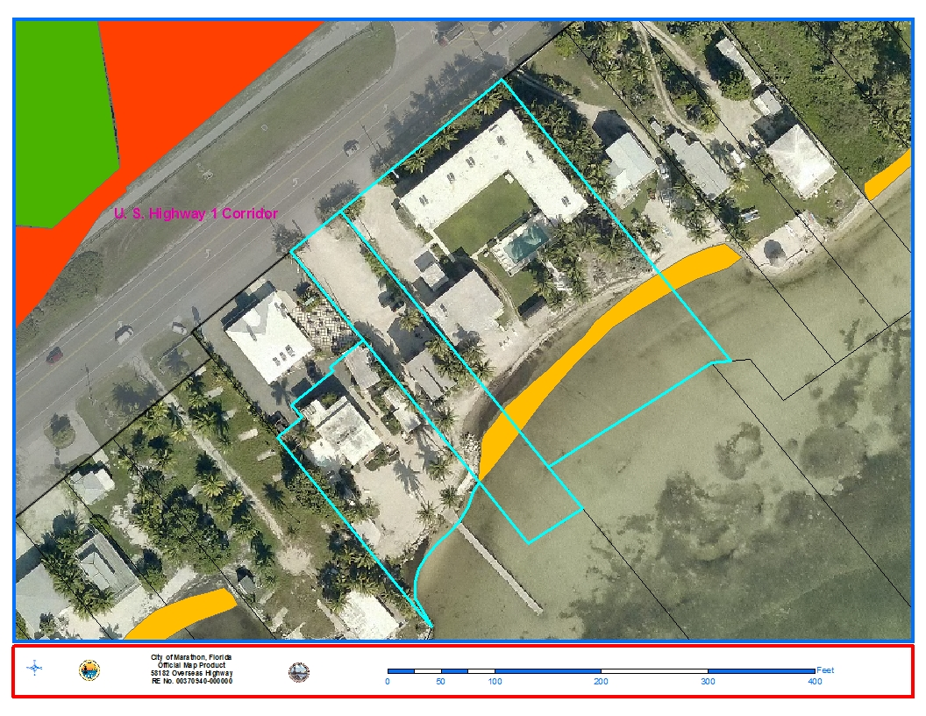
Threatened & Endangered Species – Turtle Nesting Beach
Notes:
This map shows that parts of the contiguous parcel falls under the threatened and endangered species habitat. The area for redevelopment is not in the turtle nesting beach area. However, any area within the turtle nesting beach is conditioned to comply with setback requirements.

Slide 9
Existing Conditions
Three (3) previously contiguous developed lots now consolidated into one RE No. 00370940-000000.
Developed, formerly the location of Casa Del Sol Resort and the Yellowtail Inn.
Casa Del Sol and portions of the Yellowtail Inn partially rehabilitated.
Transient Units:
23 (three properties and two motels)
Commercial FLA:
2,674 SF
Notes:
The site consists of three contiguous parcels, all developed.
Formerly the site for Casa del Sol and Yellowtail Inn which are either fully or partially being retrofitted.

Slide 10
Proposed Use
Transfer (10) transient units from Bonefish to the proposed redevelopment project.
Bonefish Resort will be considered for a five (5) unit Transient RV Resort.
Transient Units:
33 Units (one property and one motel)
Commercial FLA:
2,674 SF
Notes:
The proposed project is to redevelop the site, transferring ten units from Bonefish to this project, leaving the remaining five transient units at Bonefish to be converted into RV units.

Slide 11
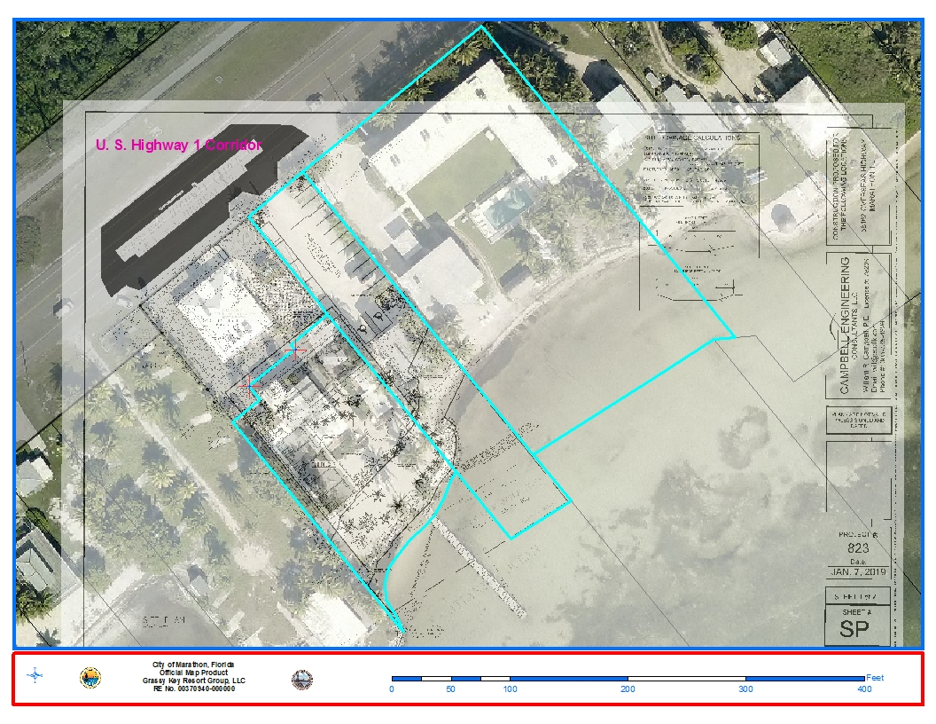
Proposed Site Plan
Notes:
Here is the proposed site plan overlayed with our most recent aerial.

Slide 12
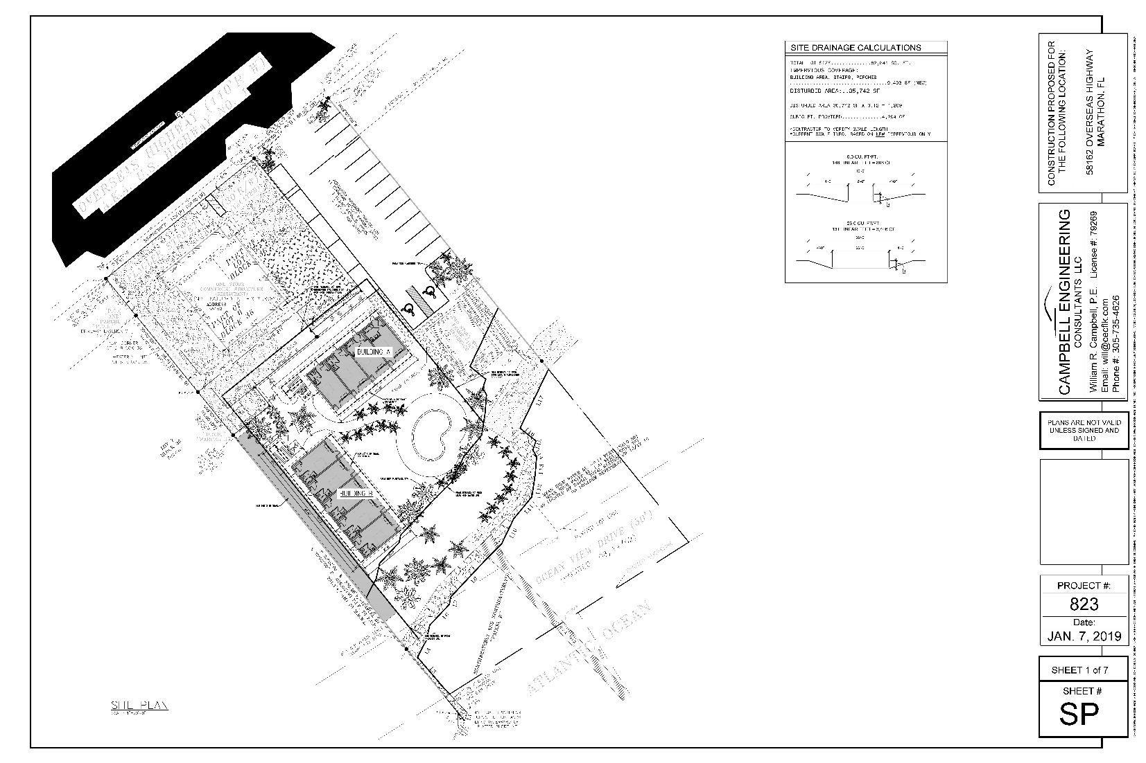
Proposed Site Plan
Notes:
Here is another image of the proposed site plan

Slide 13
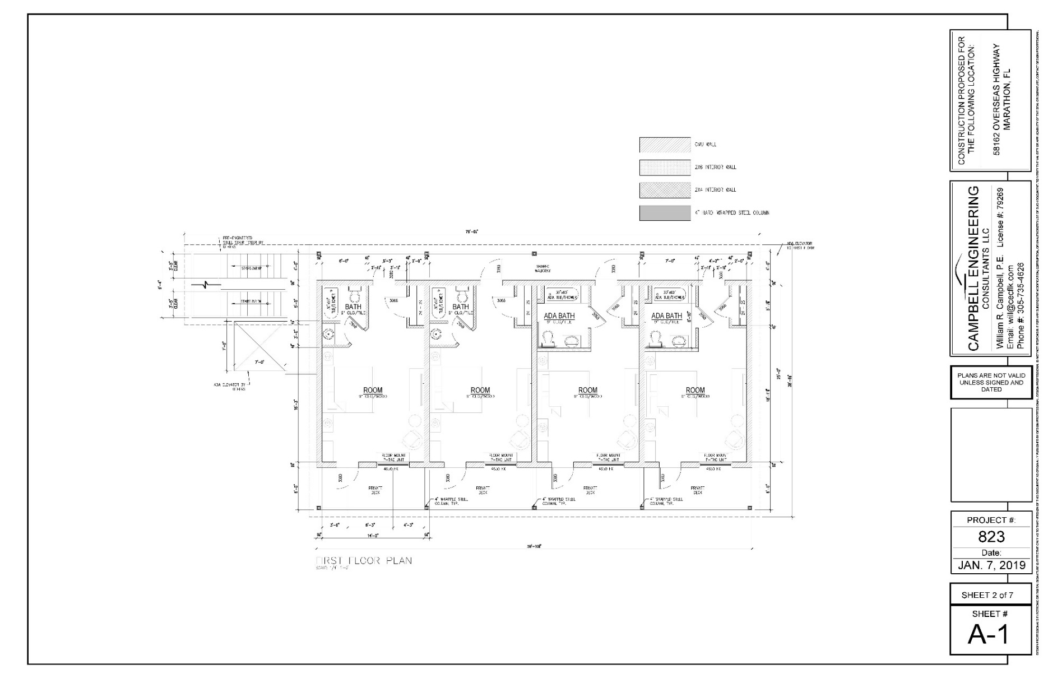
Transient Units
Notes:
Here is the interior detail of the resort units.

Slide 14
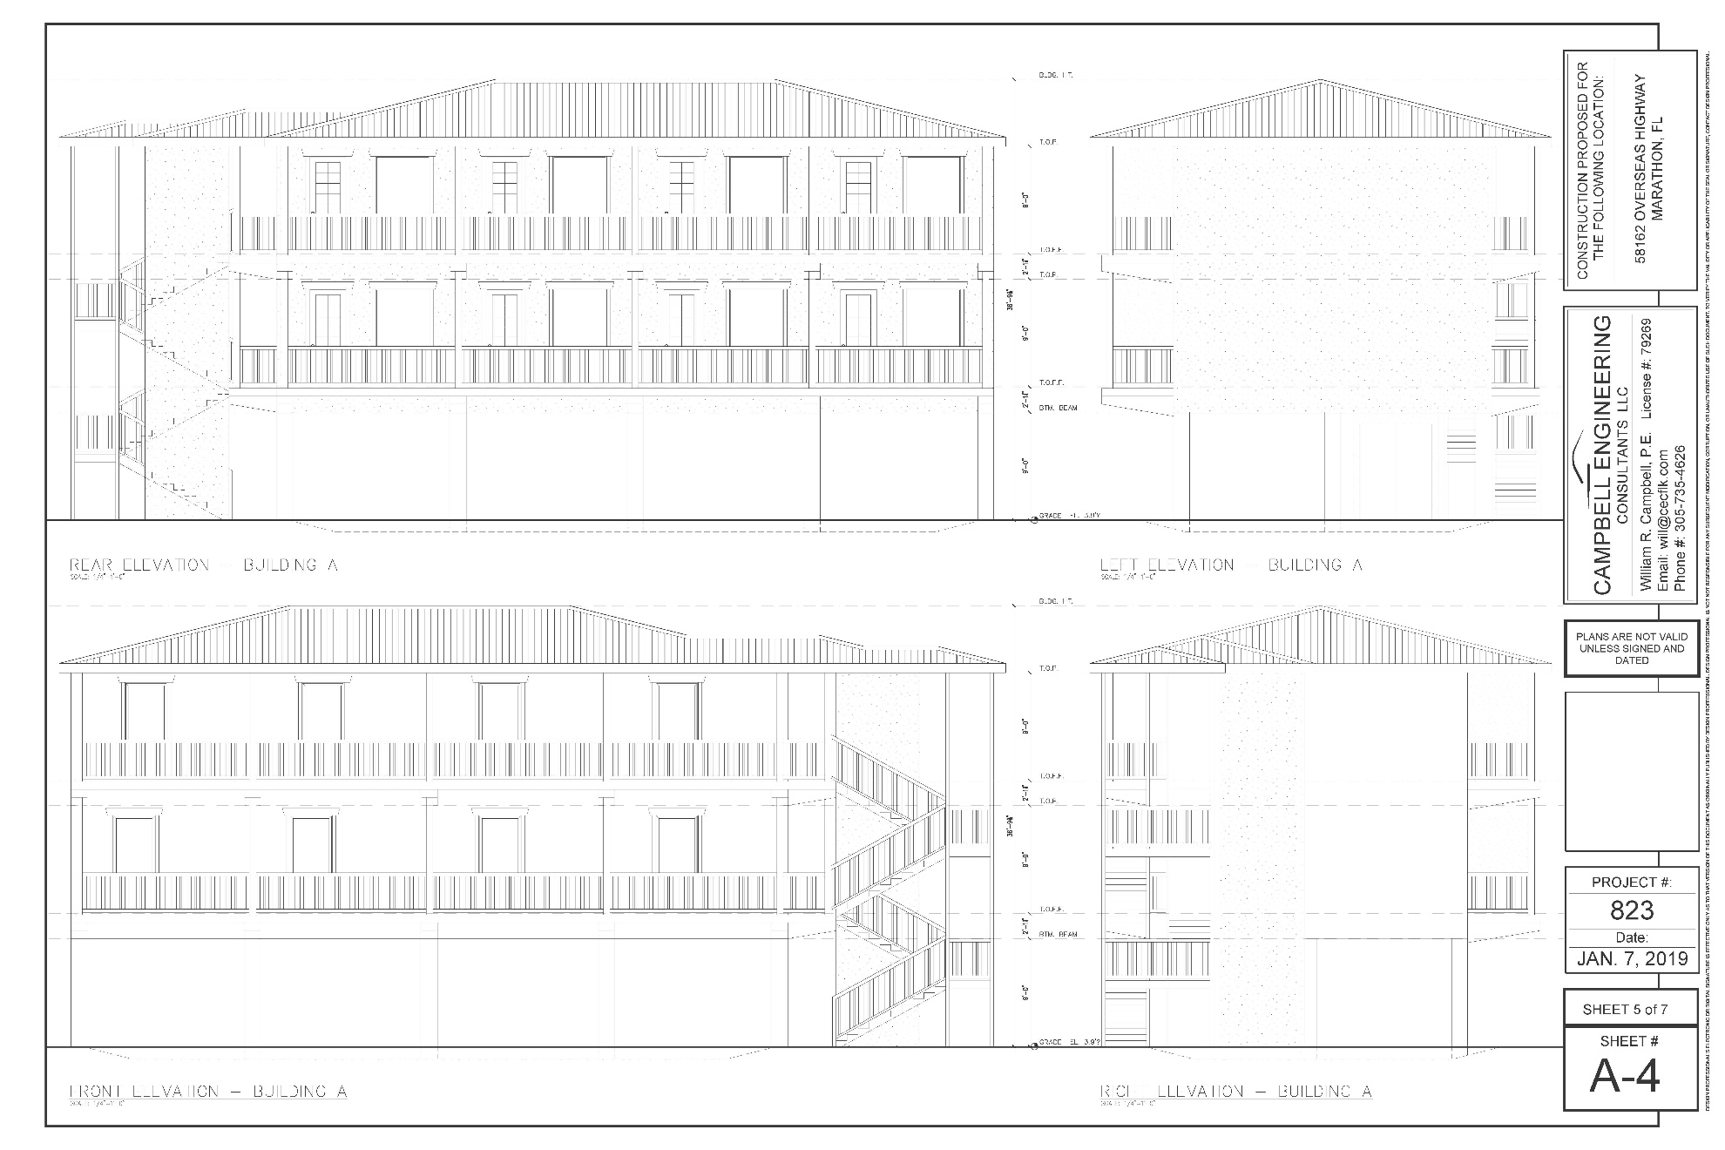
Grassy Key Inn Project
Notes:
This is how the project is proposed to look.

Slide 15
Compliance
A. The proposed use is consistent with the Comprehensive Plan and LDRs;
B. The proposed use is compatible with the existing land use pattern and future uses designated by the Comprehensive Plan;
C. The proposed use shall not adversely affect the health, safety, and welfare of the public;
D. The proposed conditional use minimizes environmental impacts, including but not limited to water, air, stormwater management, wildlife, vegetation, wetlands, and the natural functioning of the environment:
E. Satisfactory provisions and arrangements have been made concerning the following matters, where applicable:
Ingress & Egress
Parking
Noise
Refuse
Utilities
Screening / Buffering
Signs
Open Space
Notes:
Modified connection to the City Wastewater Utility will be required

Slide 16
Conclusion
The Conditional Use Approval is intended to allow for the integration of certain land uses and structures within the City of Marathon based on conditions imposed by the Council.
Review is based primarily on compatibility of the use with its proposed location and with surrounding land uses.
Conditional uses shall not be allowed where the conditional use would create a nuisance, traffic congestion, a threat to the public health, safety or welfare of the community.
The proposed development consists of the redevelopment and enhancement of a mixed use site.
As such the development, including the overall upgrading and improvement of the site, furthers the policies for development in the City and is consistent with the Comprehensive Plan and Land Development Regulations.
The project is compatible with surrounding uses, and with the below conditions is not expected to create a nuisance, traffic congestion or threat to public, health, safety or welfare.
Notes:
The project as proposed is in compliance, it is compatible with surrounding uses, and it is expected to improve the site.

Slide 17
Recommendation
Planning Commission heard the item on April 15, 2019 and provides a unanimous recommendation of conditional approval.
Notes:
Planning staff recommends approval of the project known as Serenity Cove.

Slide 18
Conditions of Approval
Redevelopment area not in turtle nesting beach. Area within the turtle nesting beach shall comply with setbacks established in P2018-0251, (Site Work), P2019-0017 (Exterior remodel), P2019-0325 (dock repair).
Clear sight triangles must be shown on the site plan at time of building permit issuance.
A detailed lighting plan must be submitted before permit issuance;
City approval is required for the stormwater management system prior to Building Permit Approval.
City approval of the modified connection to the City Wastewater Utility will be required;
The Conditional Use Development Order will constitute the Certificate of Concurrency for the project. The determination will be valid for one year; All signs and turtle lighting will be reviewed and approved for compliance with the City of Marathon LDR’s;
A final landscaping plan must be submitted prior to building issuance;
Notes:
The following are conditions of approval.
It should be reiterated that the redevelopment area is not within the turtle nesting beach, however, lots that are must comply with the threatened and endangered species requirements, mostly the added buffer of 50’.

Slide 19
Conditions of Approval (continued)
As a condition of redevelopment, the developer and the City shall enter into a Development Agreement, in addition to compliance with all other provisions of the Code.
All hotel or motels shall provide on- or off-site employee housing living space in an amount equal to a minimum of 20 percent (as may be adjusted from time to time by Council policy to reflect economic conditions) of the approved floor area in guest units;
The applicant will obtain any required permits from ACOE and DEP prior to building permit issuance;
The applicant will provide fire protection plans in accordance with fire protection requirements as outlined by the City Fire Marshall;
The applicant will meet all floodplain related requirements as part of the Building Permit process;
Notes:
Additionally, all hotel or motels shall provide on- or off-site employee housing living space in an amount equal to a minimum of 20 percent (as may be adjusted from time to time by Council policy to reflect economic conditions) of the approved floor area in guest units;

