Slide 2
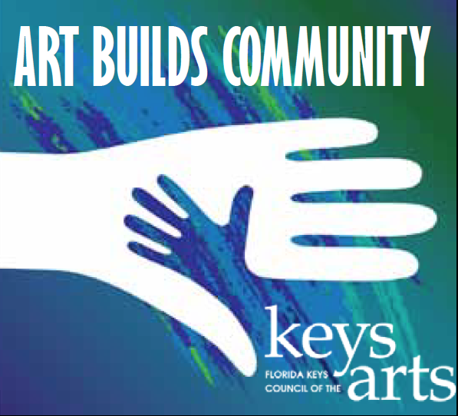
The objective of the ABC grant is to strengthen community by fostering relationships between artists, arts organizations and civic organizations within the Florida Keys to generate greater cultural equity.

Slide 3
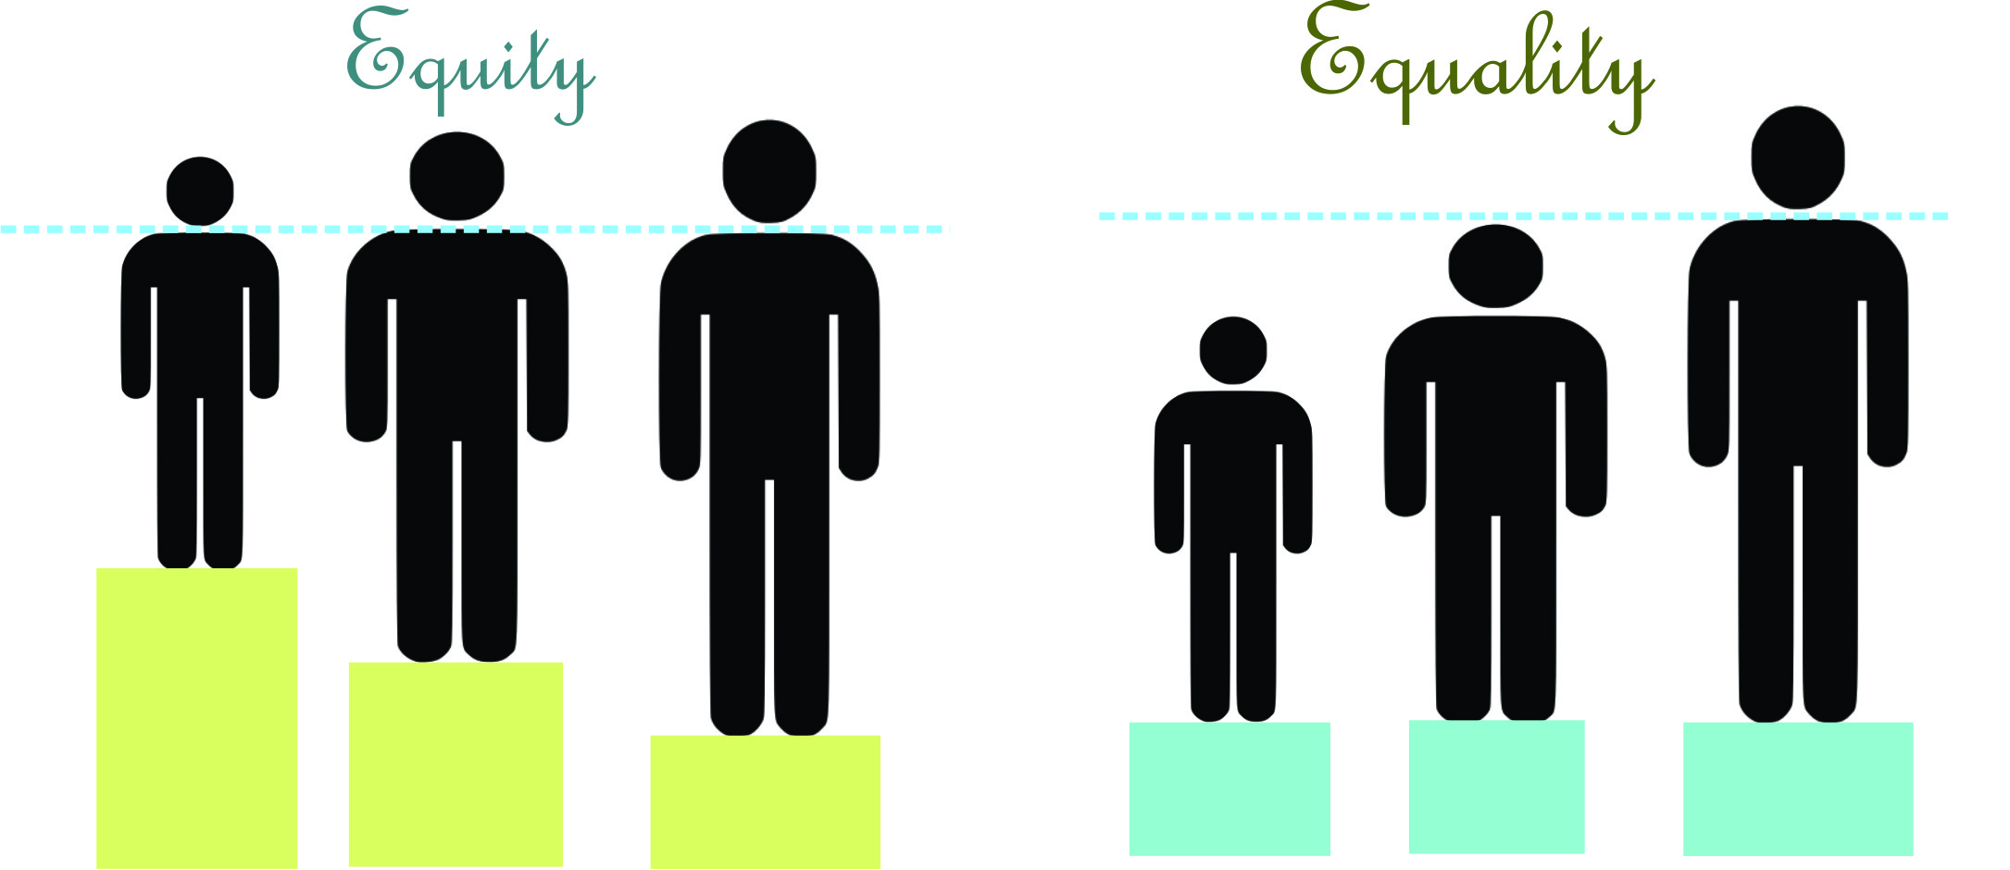
Equality
Equity

Slide 4
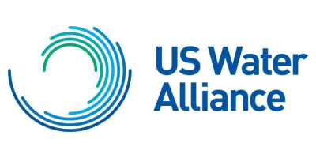
A new report published by the US Water Alliance, Water Rising: Equitable Approaches to Urban Flooding, details five priority actions that water professionals and communities can take together to advance equitable flood resilience:
1. Use data to identify risks, assets and community vulnerabilities.
2. Commit to ongoing and meaningful community engagement.
3. Set a proactive vision and build strategic alignment.
4. Fully incorporate equity into resilience planning processes.
5. Target investments in vulnerable communities.

Slide 5
Federal disaster programs are in place to ease the burden of those affected but can actually widen structural inequalities and contribute to slower recoveries for vulnerable populations.
A recent study in Social Problems found that in counties with disaster damages of at least $10 billion from 1999 to 2013, white households gained an average of $126,000 in wealth, while Black and Hispanic households lost an average of $27,000 and $29,000, respectively.
The study determined that federal post-disaster assistance contributes to rather than mitigates this phenomenon.

Slide 6
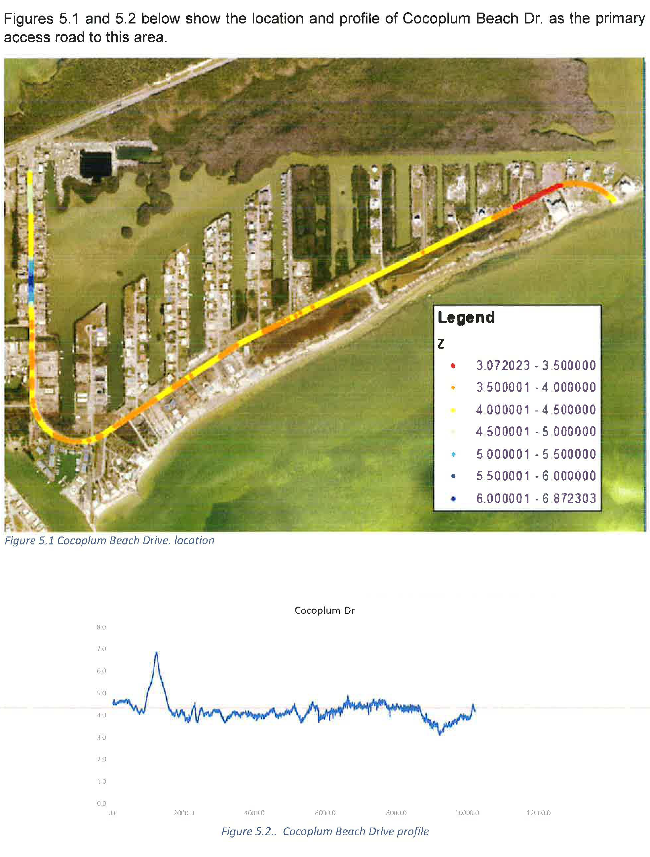
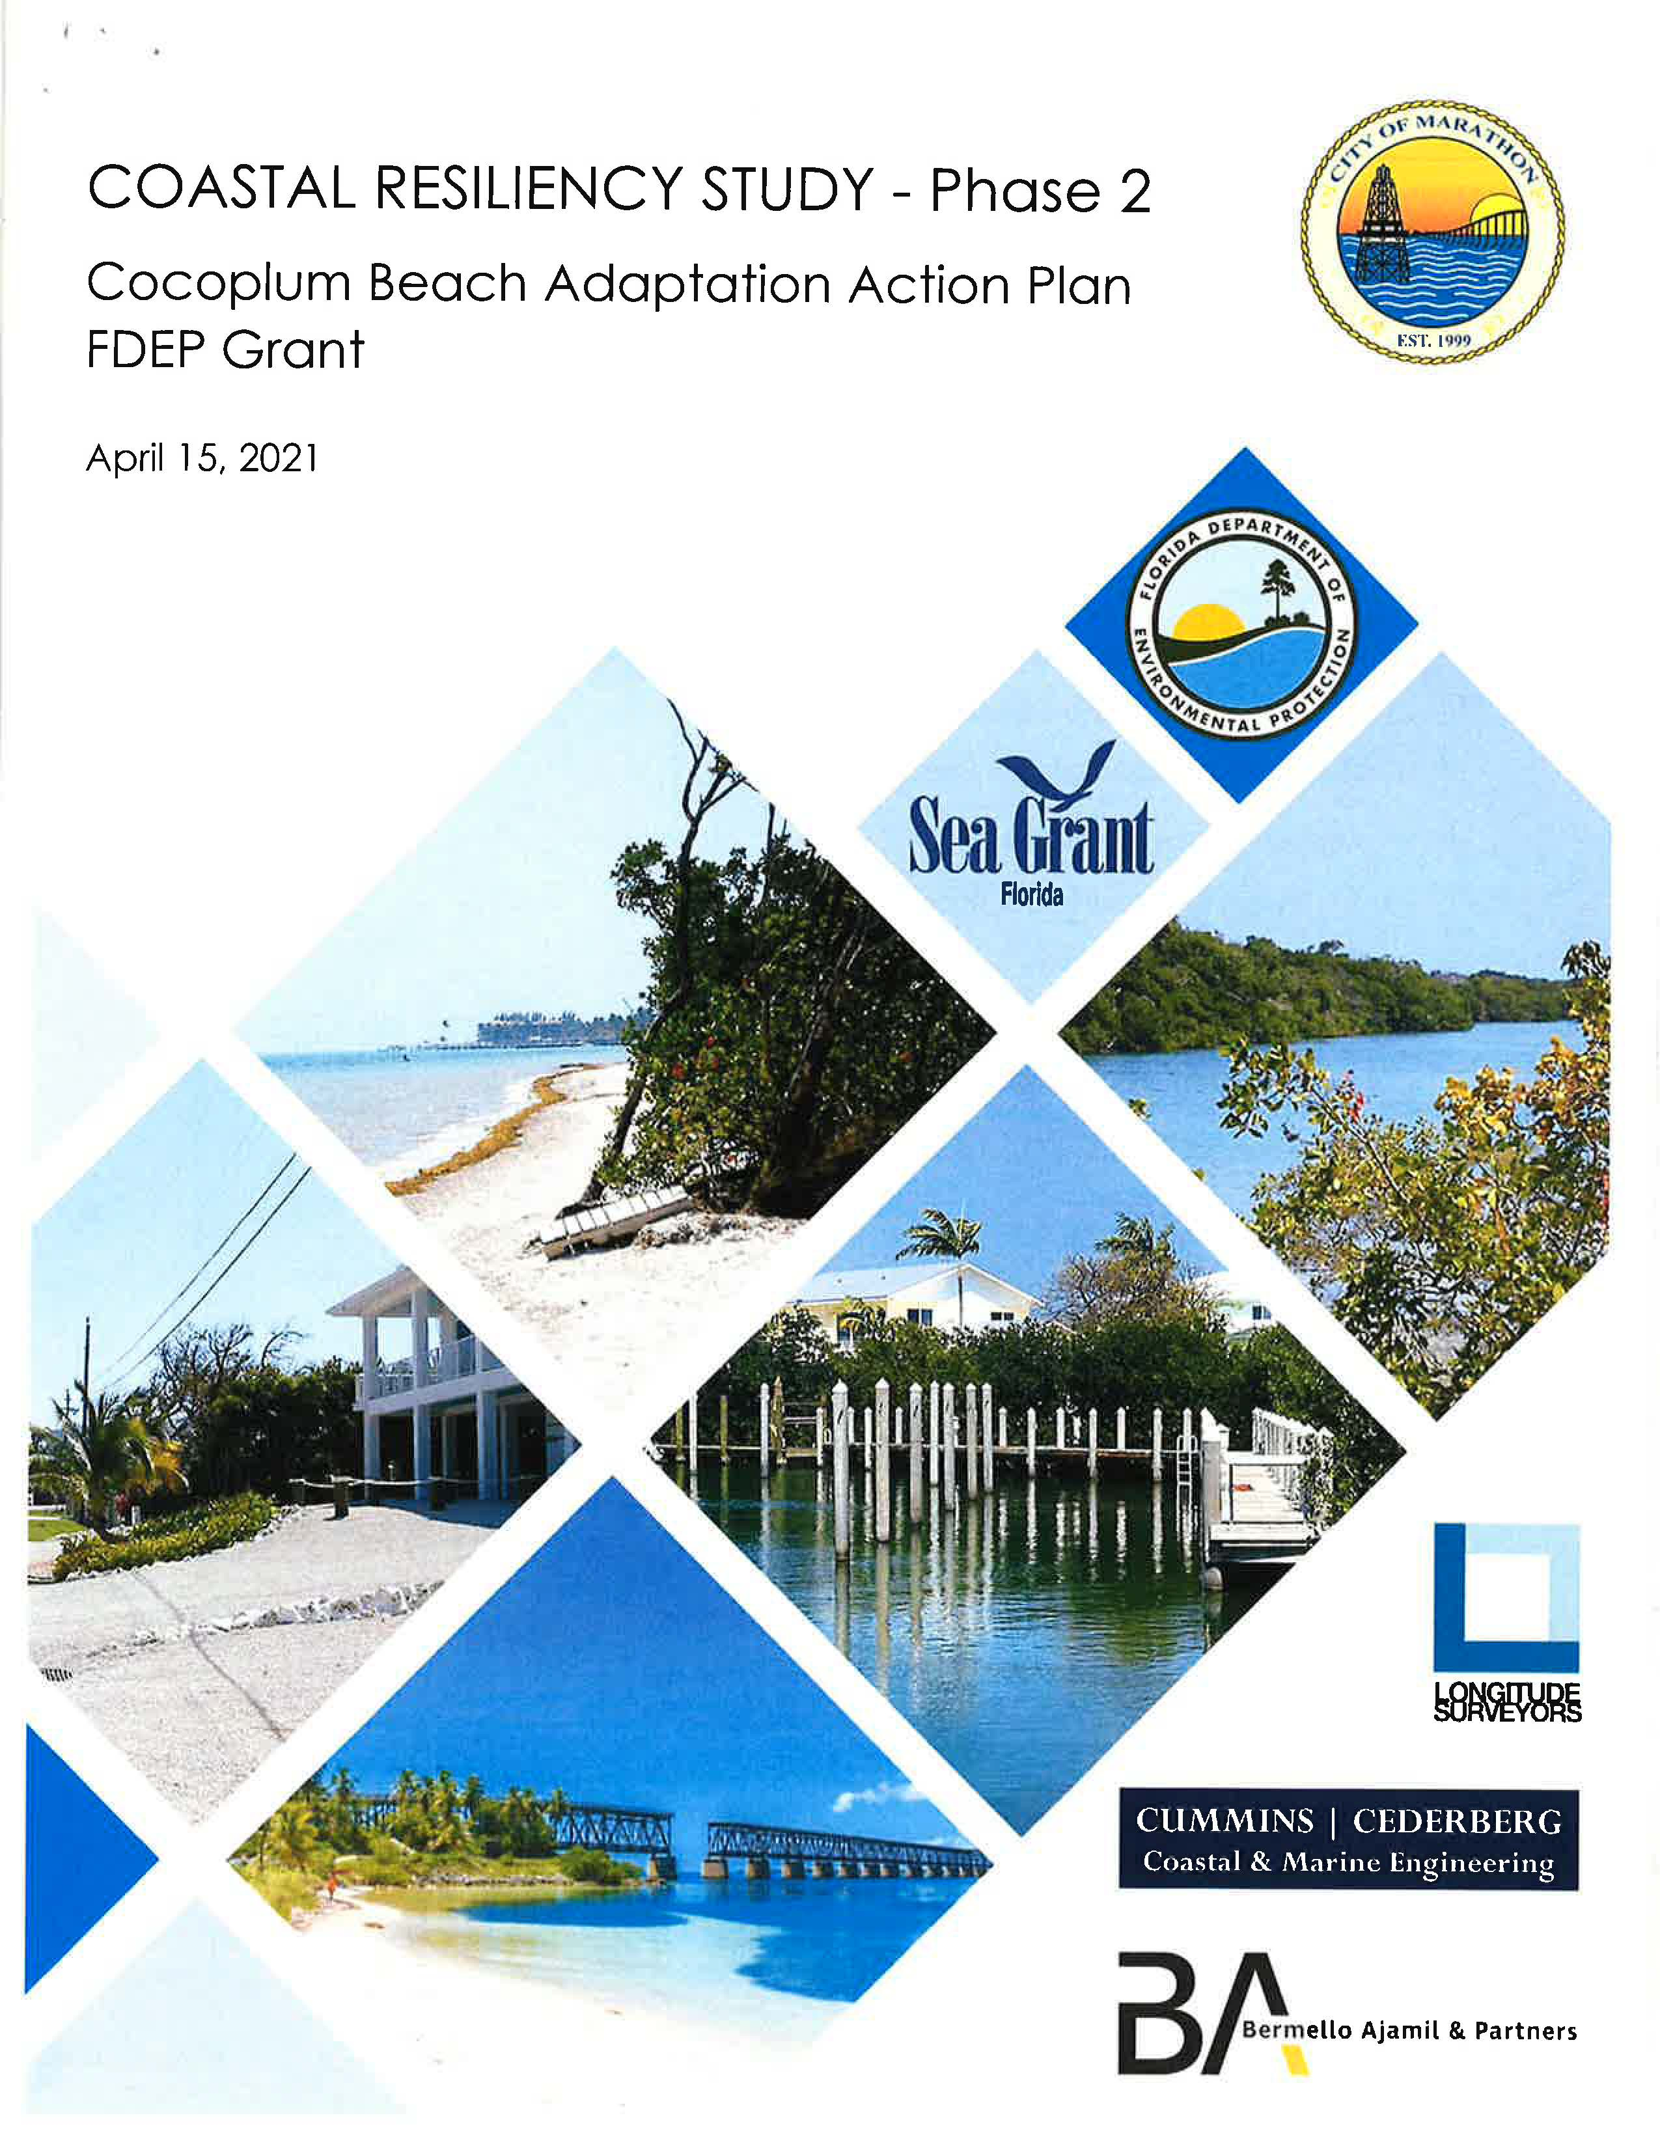

Slide 7
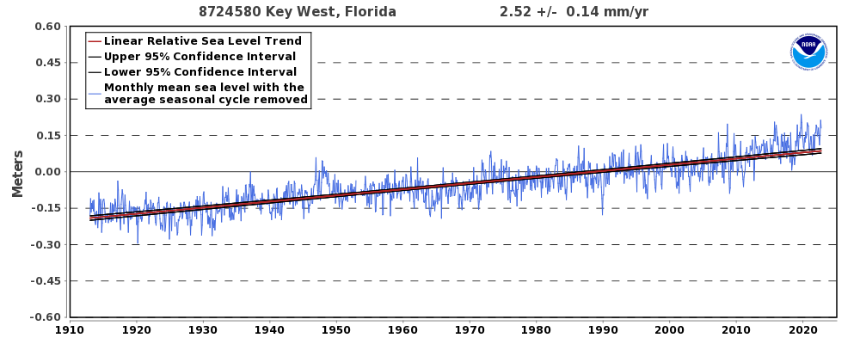

Slide 8
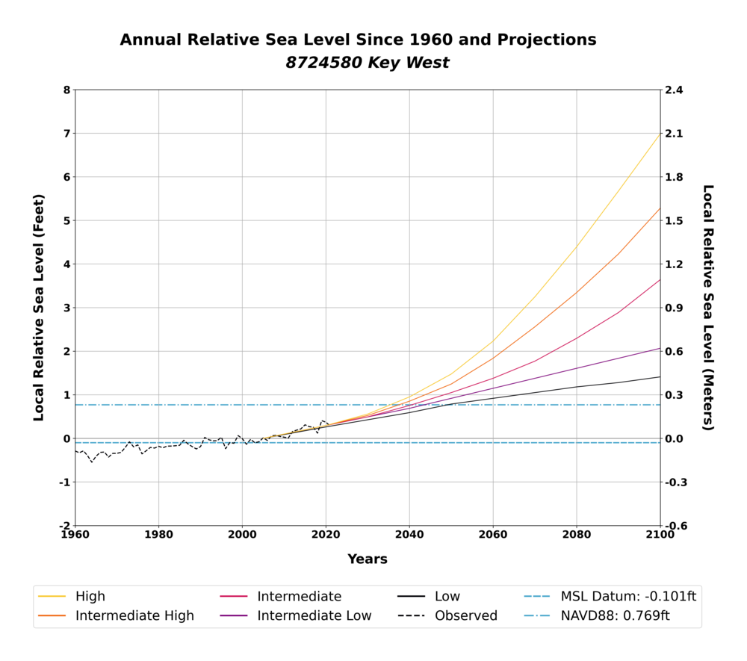

Slide 9
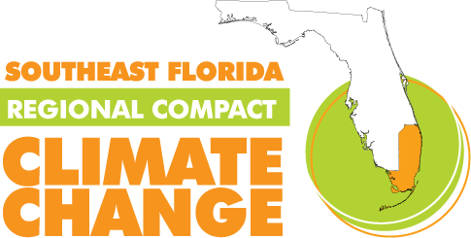

Slide 11
https://coast.noaa.gov/slr/#/layer/slr/0/-9012455.083744986/2845618.971118887/14/satellite/none/1/2050/interHigh/midAccretion
https://monroecounty-fl.maps.arcgis.com/apps/webappviewer/index.html?id=470784a6537b401f80e26ff4885ea2a4

Slide 12
Thank You

